Slide 1


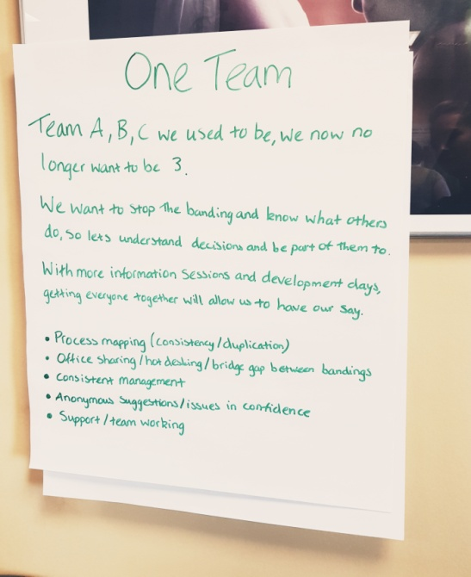
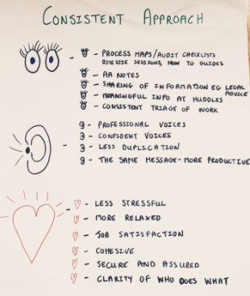
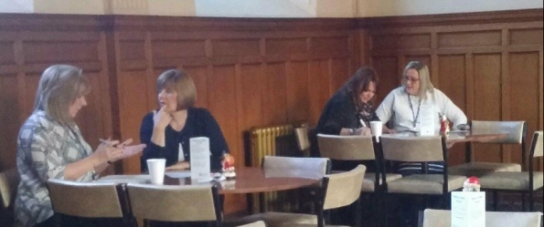
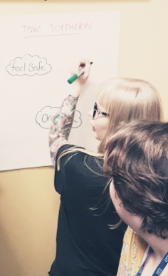
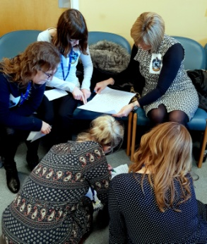
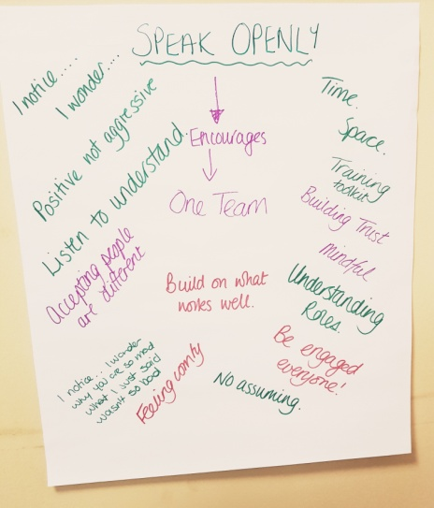
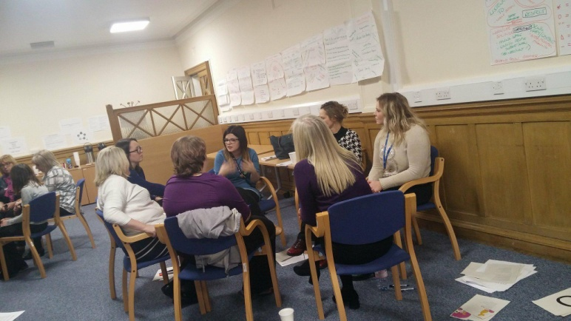
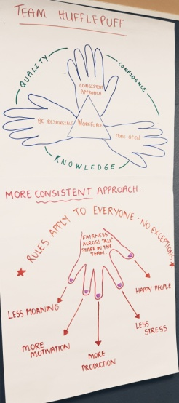
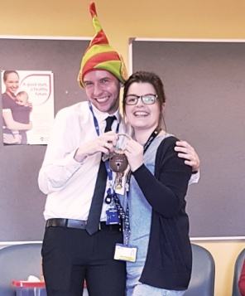
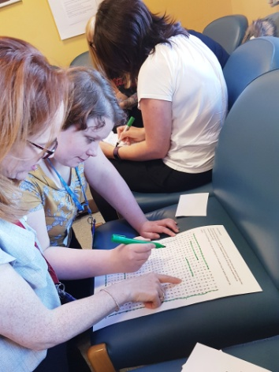
We are using Appreciative Inquiry to help us become even better.
Being one whole team is really important, so, much so we wrote it as a poem.
One Team Together
Define
Discovery
Dream
Design
Destiny
By understanding the magic we all have inside.....
We can start to see what we are like in the team when we are at our best .
We used our iMatter results as a starting point for defining what we want to change.
We know what makes a good team...
We asked each other our high points, our values and our achievements
Because.....
And we discovered how our teams contribute to our high points.
We are one!

Slide 2
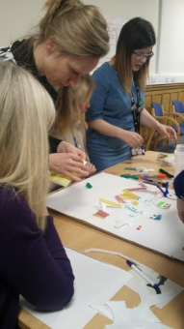
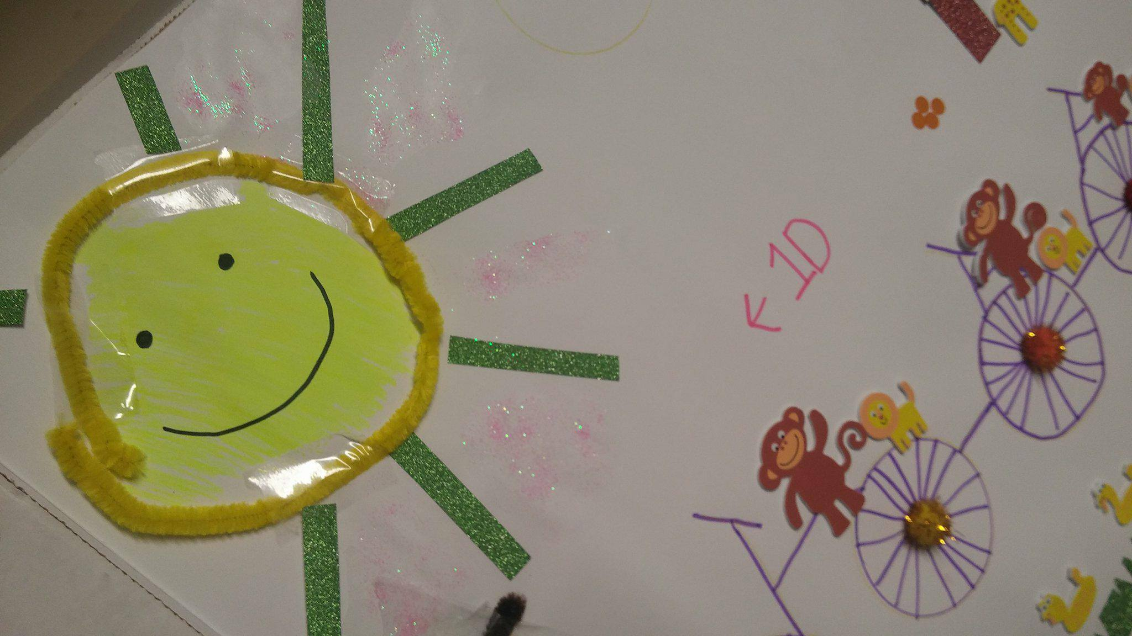
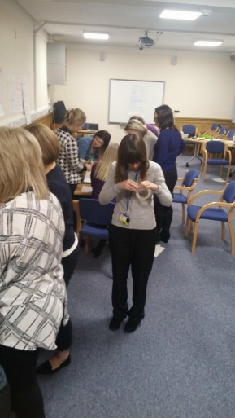
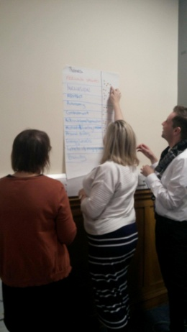
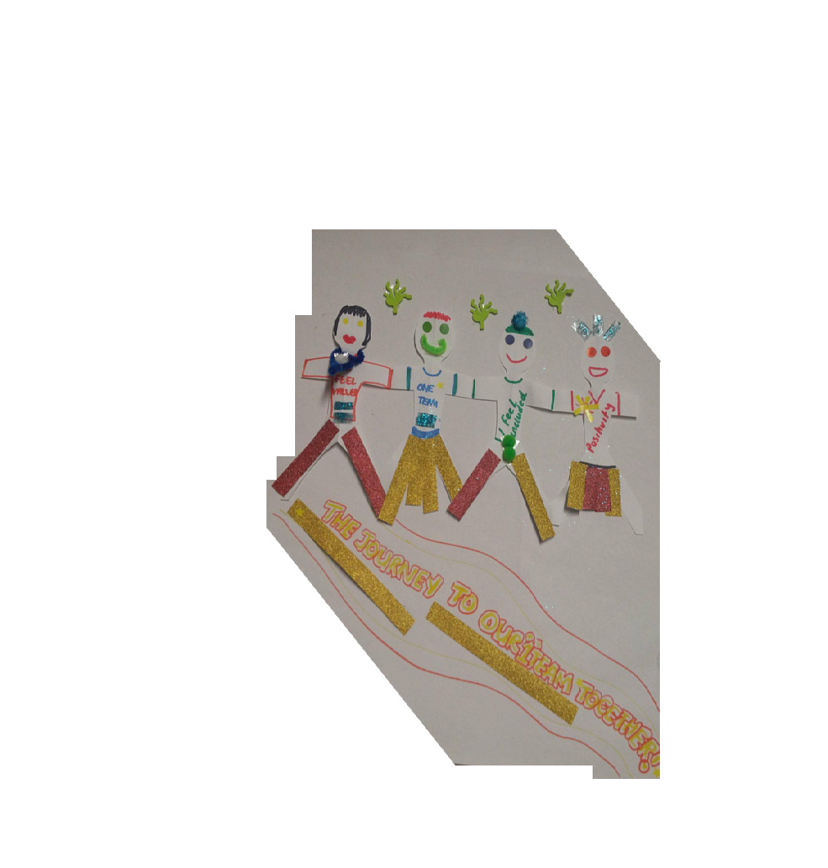
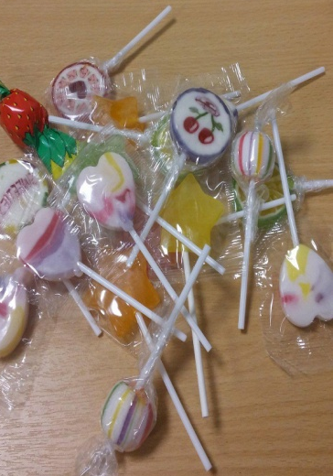
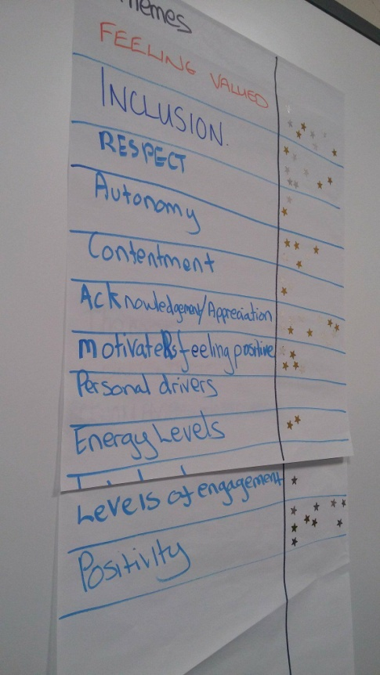
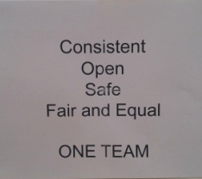
AI is rewarding and difficult all at once so a few times we had to stop and find the end of the sticky tape again.
Focusing in and funnelling down these great discussions we realise how much we have to give.
And that is ok, because the best journeys are not straight paths.
Reaching for the stars and exploring what we all want more of in our one team.
“I can’t draw” wasn’t an option - we had to describe our key themes in one image – suddenly anything is possible when the sun is shining!
We can draw strength from our diversity and the endless stories we bring to that journey .
Whilst we are still on our journey towards one team, we are on the path together....
Throughout this we have this shared belief (as well as lollies).

Slide 3
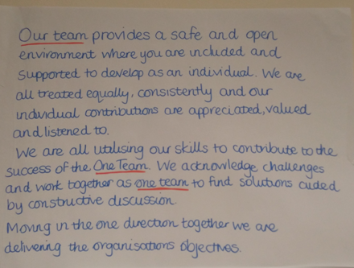
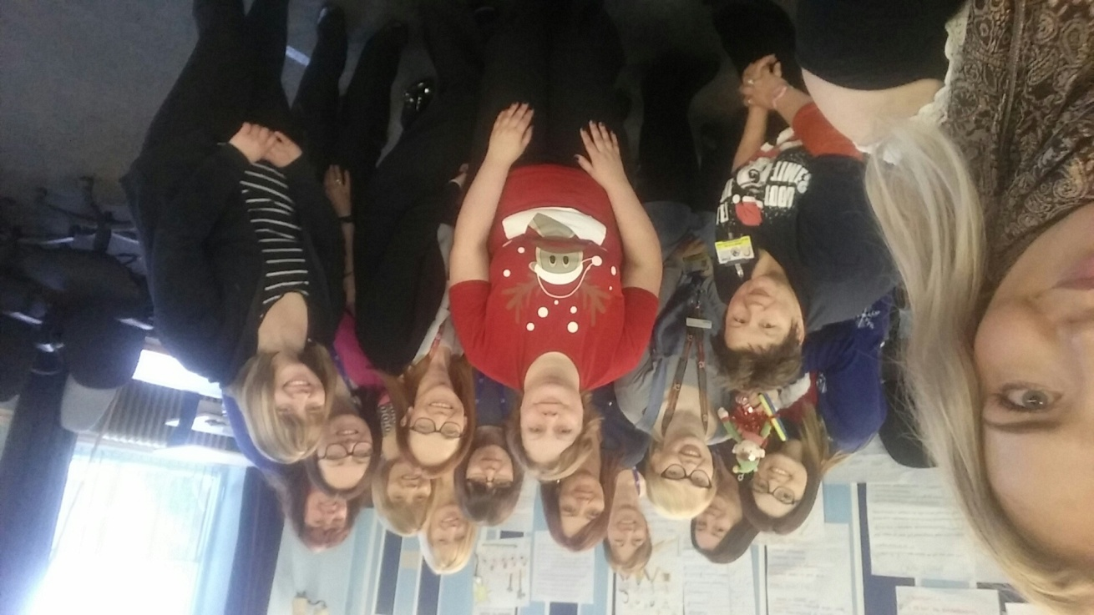
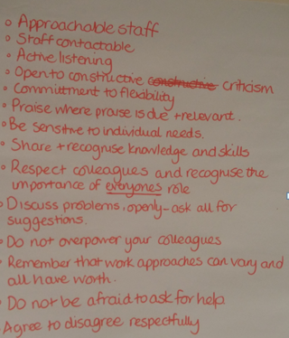
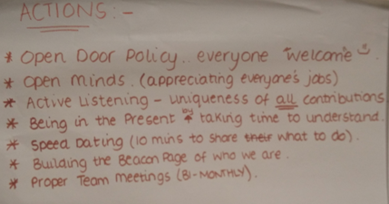
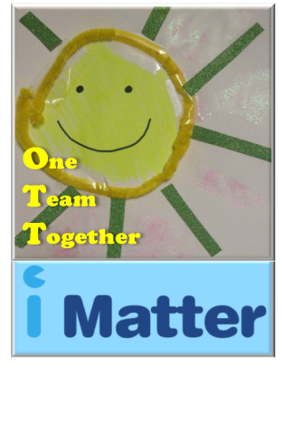
...Our Workforce ‘One Team’
1. A definition of who we will be
2. Describing how we will be that
3. Our first actions towards achieving our One Team!

