Slide 1
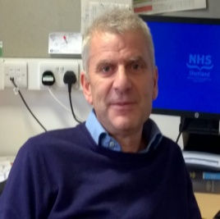



Life After iMatter...
What’s changed
For Estates and Facilities Staff?
Communication......How?
Staff meetings now in place –
All Staff Meeting
Supervisors Meeting
Joint Estates and Facilities Supervisors Meeting
CEO agreed to attend two meetings a year
All meetings are informal, everyone has a voice!
We still have Lawson – Head of Estates and Facilities
Feeling of Value
Staff are engaging with education (SVQs), NES pilot project, iMatter, Appraisal training for managers and much more!
Appraisal – Keep Calm and have a Yarn!
Sickness/Absence – reduced!
Moving Forward – Looking to the future...
Issues from meetings now escalated through Head of Estates and Facilities....We have a voice!
Project to support Digital Learning....Everyone will be able to access iMatter via a computer and is comfortable with completing the questionnaire electronically ☺
Empowering supervisors and staff with appraisal
Spice Girls!
Tell me what you want, what you really, really want!
Relationships Improving – open and honest conversations....
Good cop-Bad cop

