Slide 1


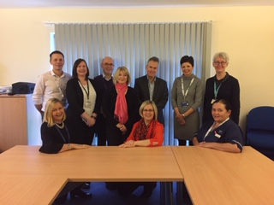

iMatter – being the best that we can be!
Nithsdale Health & Social Care Locality Management Team

Slide 2

2017 iMatter Action Plan Success!
In response to the results from the 2017 survey we stepped
into 2018 with a 4 session team development programme
facilitated by Organisational Development
88% Completion
83 EEI
This began with a celebration of our achievements in 2017 and creating a word cloud to describe our team.

Slide 3
2017 Actions...
In turn this led to a number of other actions including
a survey of Nithsdale staff around their views of integration and partnership / team working and taking the opportunity to ask team members about what matters to them as a member of the team.
A Multidisciplinary Team workforce forum was formed to ensure we heard everyone’s voice.
We embarked on staff engagement sessions for the wider Nithsdale team in June and September 2018 with approximately 80 staff members attending each session. Feedback has been really positive and further sessions are being planned.

Slide 4
See it, think it, say it!
At the Nithsdale staff engagement event in September 2018 we invited feedback, using an appreciative inquiry approach, from the larger Nithsdale workforce on 4 topics which had been discussed at management team:
How can we support each other’s health and wellbeing at work?
What do you need to feel even more empowered?
How can we develop our creativity?
What else... If you see or think it, say it?

Slide 5

Continuing into 2018!
Response to the 2018 survey was 89% with an employee engagement score of 85. This was a slight increase on the 2017 results which was really encouraging.
The results suggested that as a team we create an environment which people feel is a good place to work, where their health and well being is considered and our management and support team are approachable and supportive towards each other.
When completing our action plan we agreed that it was important to link the iMatter results into initiatives around Healthy Working Lives.

Slide 6
Being the best that we can be!
iMatter results 2018 reminded all of Nithsdale management and support team that we need celebrate that our team offers a really positive place to work. However, not being complacent the actions we have identified build upon the 2017 results as we also recognise that we need to be the best we can be, both in terms of performance and staff support at department and locality level. The challenge is to do this in a way that is both effective and engaging of the wider Nithsdale team and to build this in a sustainable way across the locality.

Slide 7
We are on a staff support journey in Nithsdale and iMatter reports are a welcome addition in sense checking the actions we require to undertake across the wider locality in supporting our staff

