Slide 1

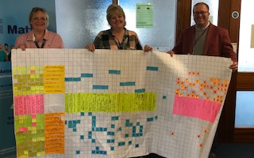
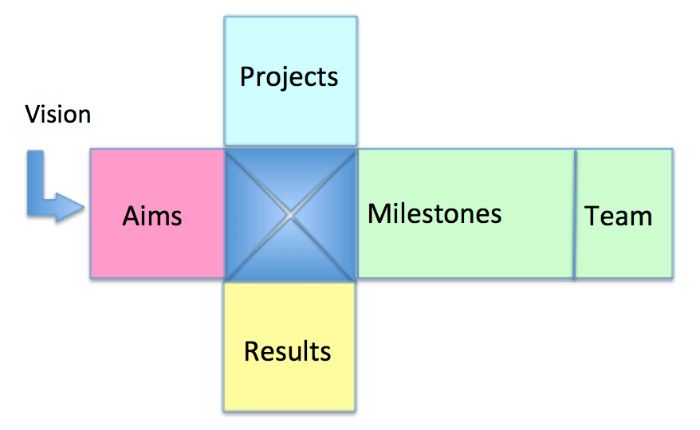



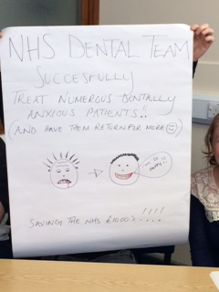
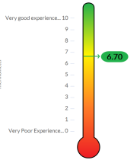
Dental Services SDM Journey
Strategy Deployment Matrix – Strategy on a page
Who took part...
Dental staff from across all 4 sites including the Clinical Director and Head of Primary Care
Head of OD facilitated development session
Collective feedback from iMatter used to develop a bigger improvement plan
Things would be even better if........
Improved team behaviours
Better planning and priority setting by establishing departmental goals
Communication between teams is improved and actions are communicated and monitored
77% response rate
78% EEI
Standard of patient care is good, the recent management re-organisation is seeing improvements
with iMatter
Improve response rate for 2018
Develop Dental Services SDM
Develop Dental Services Newsletter

