Slide 1
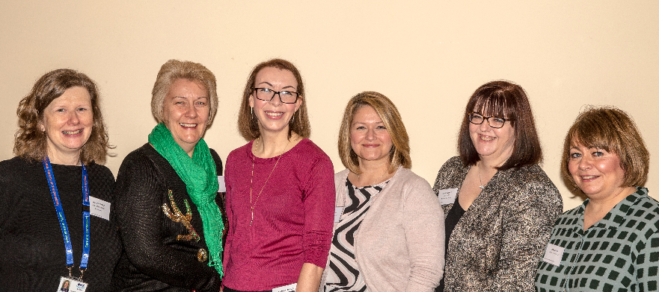
NHS Lothian iMatter Team Case Study
HR & OD Directorate
NHS Lothian – HR & OD Development Event
January 2016

Slide 2
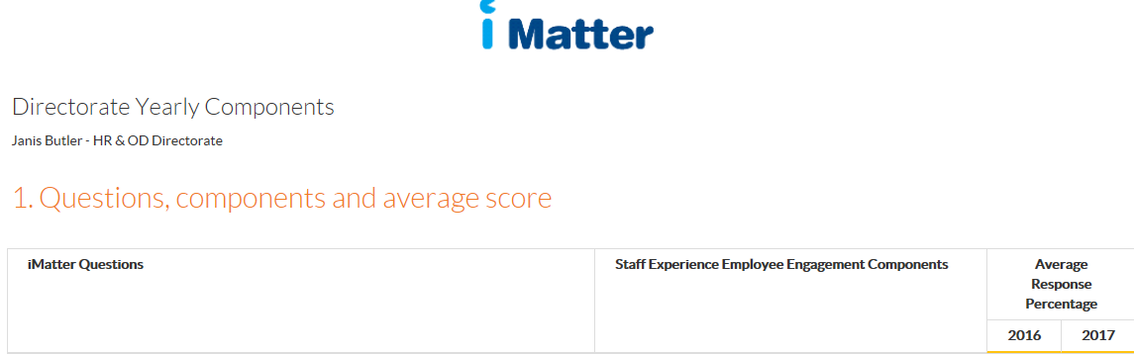
Background
2016 - HR & OD directorate go though iMatter for the first time.
The four lowest scoring items in the 2016 Directorate Components Report related to the relationship between staff and the wider organisation.
Following a discussion with the Senior Team, it was agreed to organise a Directorate-wide development event, to help improve these scores.
Two separate events were run, to allow all Directorate staff to attend one event. The Senior Team attended both events.
The 2017 Directorate Components Report show improvement across all four items.

Slide 3
A small planning group, comprising individuals from across the Directorate, was established to develop an agenda for the day. The aim was to:
  address some issues raised in the iMatter report
  hear from our newly appointed interim HR &OD Director, and
  get to know our senior team better.
A element of personal development was included, and we invited speakers from Staffordshire University to address the theme of ‘Resilience’.
On the day, we heard from the interim HR & OD Director, the Senior Team and guest speakers. Staff had the opportunity to meet colleagues from other departments, across the Directorate.
We developed a Flash Report, following the event, which summarised the themes from each event.
We agreed to hold a further event in December 2017. The main theme will be ‘Quality’ - ‘What does quality look like for HR & OD and how do we measure it?’

Slide 4
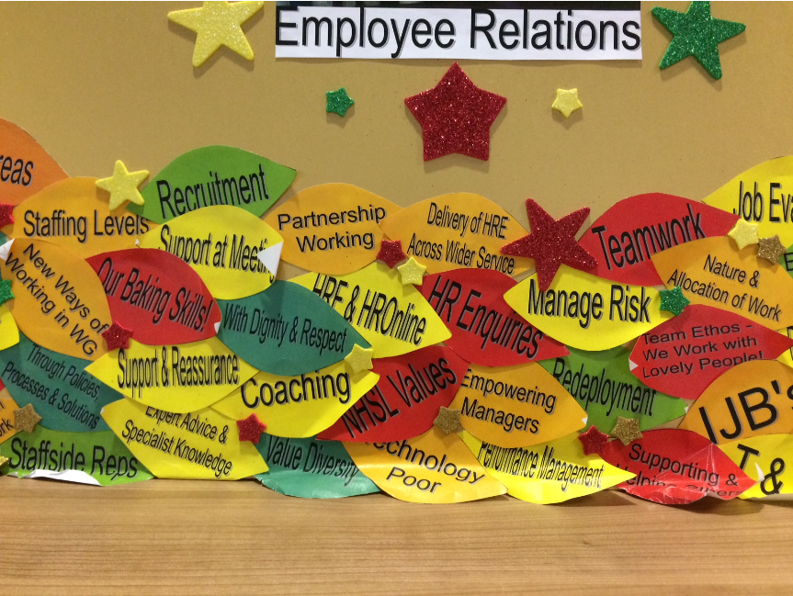
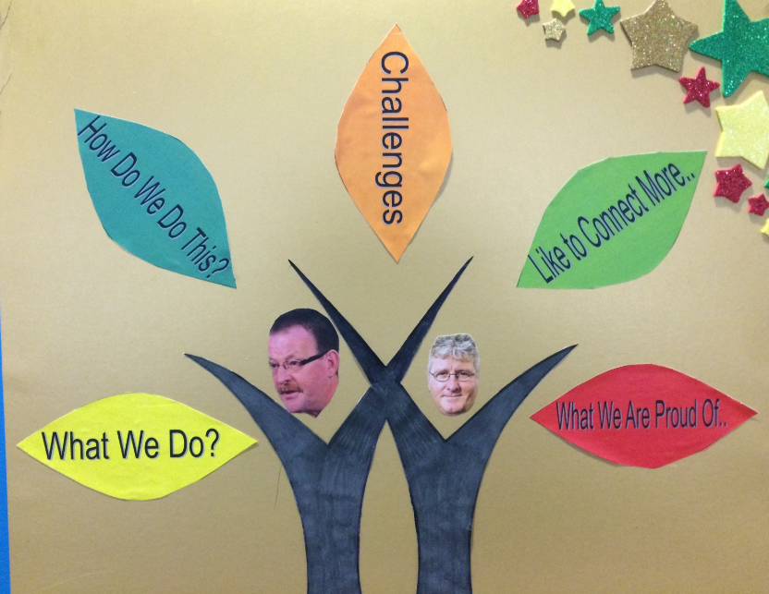
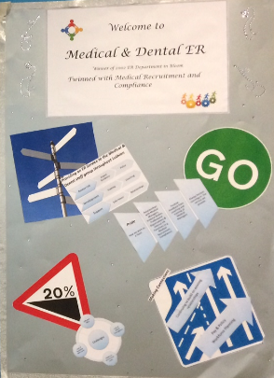
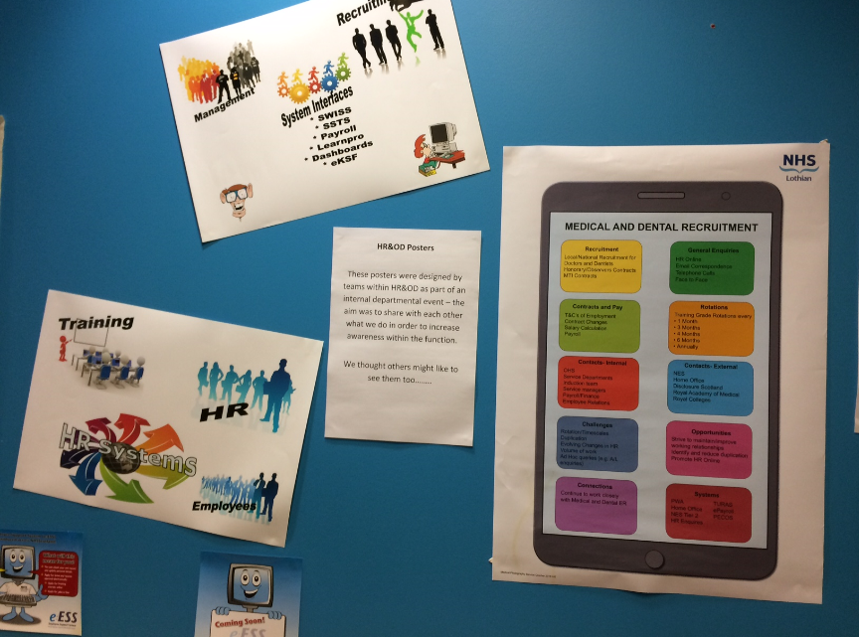
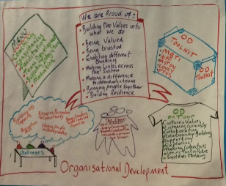
Each team was asked to design a poster, describing their work. These showcase the variety of issues being handled across the Directorate. The posters were displayed at each event, and have subsequently gone ‘on tour’ to our main sites, to let all staff know what we do!

Slide 5
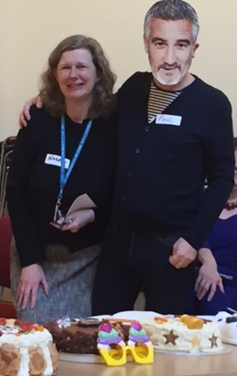

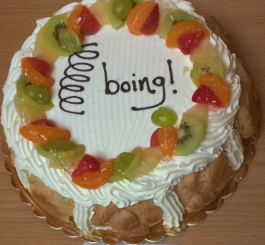
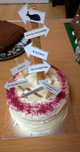
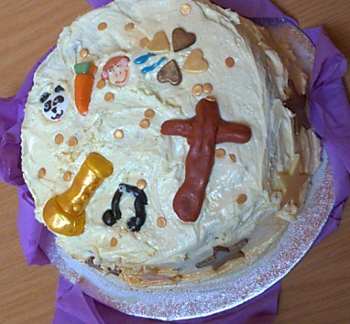
No away-day is complete without a treat, so each of the senior team were asked to ‘produce’ a cake for each event. In order to increase visibility and for staff to find out more about them, they were asked to say something about themselves, and something about resilience – the theme of the event. The cakes were then ‘judged’ by a Bake Off ‘celebrity’!

Slide 6
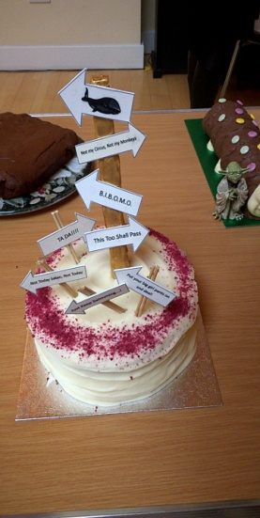






Our Resilience Matters – highlights from keynote speakers
Follow-up actions on resilience already happening……..
Key themes highlighted by Staffordshire University included:
Smarter Thinking (structured way of rethinking adversity)
Challenge & Threat States (getting in the right mind-set for adversity)
Resilient Culture (resilience can be developed spread across groups)
We learned about ‘4 Sporting Ways to Resilience’ and your toolkit should now include these simple exercises:
1.Manage Self-Belief- ‘be a good coach to yourself’ 2.Control the Controllables – identify the performance factors that you can control
3.Focus on gains, not losses – choose a “pinch-point” and develop an approach focus
4.Develop and be part of a strong, supportive team – think of a new way to provide informational, tangible or emotional support to team members
Thank you to our Heads of Service for sharing their personal approaches to resilience, for participating in the Bake-Off and allowing their cakes to be judged – they most certainly demonstrated resilience under each mouthful of cake tasted by the lovely Mr Paul Hollywood!
The Heads of Service are committed to supporting and working with their respective teams to build on what we learned at the event and what this will look like from an individual and team perspective. How we learn to face adversity, how we learn to think smarter and build a resilient culture and being aware of what others are facing (Claire Smith’s story). And of course, how we develop a strong and supportive team that will equip us during challenging times!
See Further Information below for links to the materials from Staffordshire.
Current policy landscape…….
Themes from Table Top discussions
Although just a few months into post, Janis shared her thoughts on the current climate……..
“The HR&OD Agenda is a busy spot, against a backdrop of government reform of public services, rising demand for services, rising costs and limited resources in healthcare.
Our agenda very much mirrors some of the key messages in the National Clinical Strategy – proportionate and realistic medicine ( HR support?), focus on prevention, anticipation and supported self management (HR online would be an example of this). ‘Once for Scotland’, collaboration, co-production and co-implementation are very much at the forefront of our national HR Shared Services Agenda. It’s also vitally important that we do only the things that we (as an HR& OD function) can do to support and enable safe and effective patient care – we need to be realistic and choose wisely.”
What could we do to improve on senior management visibility, staff experience and any ideas for what could happen next?
Some of the ideas gathered were:
Annual gathering of HR & OD department
Protected time for smaller gatherings of teams.
Regular communication/publication
“Real Stories” like Claire Smith’s
More information on what senior managers do.
Photos and bios of senior team on HROnline.
What is our corporate identity?
More staff engagement, but not a walkaround.
Walkabout at service delivery level
Engagement with staff at personal level.
As we approach our iMatter anniversary cycle, we shall be considering these ideas as we look at our approach to communication and engagement as a service.
Notes:
6

Slide 7
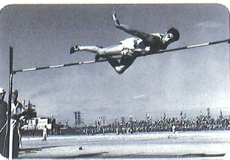
Your Feedback
Future priorities for HR&OD
Overwhelming positive feedback on the day – some ideas for how we can improve too which we will take on board. In the spirit of the message about staying resilient - here are some of the positive comments:
“Good to have a chance to step away from desk”
”Good to get some information regarding the organisation/departmental vision”.
“Good to see posters from other areas of HR & OD”
“Set table plan, a good way in meeting people from other areas of HR & OD”
“Resilience session was fantastic!”
“Being together as a team and everyone getting the message at the same time”
“Well organised - Liked the style and variation of the day.”
“Visible leaders”
“Good to have a better understanding of all the demands faced by each team and their achievements.”
“Positive energy in the room through out the day”.
“Bake off great way to learn about each leader – visible leaders”
“Engaging without pressure to take part”
“Felt involved throughout the day”
“The openness and honesty of the conversation “
THANK YOU!
In terms of what we need to be focussing on in the future, here are Janis’ thoughts:
“In my first few months in post as Interim Director of HR & OD my assessment of our priorities for actions is:
We need to be role models for ‘Our Values into Action’ and iMatter
Refresh and re-energise our approach to Staff Governance
Create a framework for staff engagement and experience ( becoming a listening organisation)
Develop a strategy for a sustainable and integrated workforce (a planned & multi-professional approach, up our game on Modern Apprenticeships).
Review the leadership arrangements for EED
Become advocates for leadership development
Become champions of quality improvement
Use big data and technology to enable and support our customers
Influence the national HR Shared Services Agenda
Keep the show on the road!”
Some quotes on resilience ………
“Resilience is not about ‘bouncing back’, you are not a rubber ball…. Resilience is about flexibility.”
“You can’t lower the bar…you need to rise to it.”
Prof Marc Jones, Staffordshire University
“We are what we repeatedly do….excellence, therefore, isn’t just an act, but a habit and life isn’t just a series of events, but an on-going process of self-definition” Aristotle
What next?
Further Information
The planning team have already started thinking about an event for 2017, so if you have any ideas please email them: Lindy Manson, Tracy Stewart, Susanne Newlands & Kris Aitken.
SAVE THE DATES:
8th and 13th December 2017 – Faith Mission
If anyone would like to complete an on-line questionnaire on personal resilience go to www.testyourrq.com. This is a questionnaire we recommend to participants on our Playing to your Strengths Leadership programme and the feedback is very positive.
Copies of Staffordshire slides and workbook are also available on our HR&OD Forum on the internal intranet site along with Janis Butler’s presentation.

