Slide 1



Positive Team Culture in Community Midwifery
Back in 2016, teams in NHS GGC Women & Children's Services began implementing iMatter.
Through a series of awareness sessions, managers knew what needed to be done and the benefits it brought
Sandra Taylor saw how this could work in her team of community midwives, and shared details of the iMatter process with them
Despite not being based in one place, and the role means they are regularly out and about – they all decided to complete electronically and as one team – giving the opportunity to come together and discuss actions

Slide 2
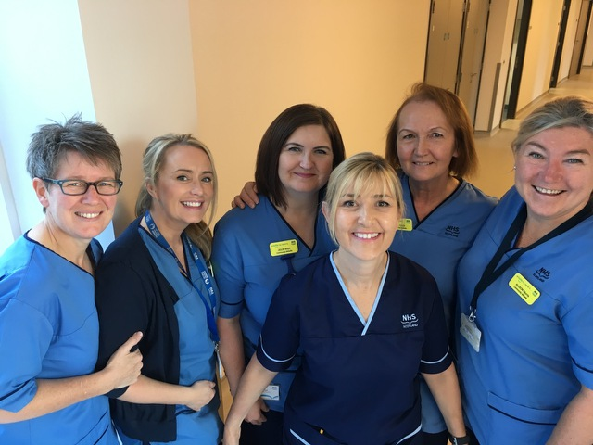
Positive Team Culture in Community Midwifery
MEET THE TEAM!

Slide 3



Positive Team Culture in Community Midwifery
Response:
2016: 73%
2017: 91%
Action planning
The team met together, in one place, and brainstormed ideas
They owned the report, lead the discussion and came up with a well thought through action plan
Knowing each others strengths, skills and experience helped identify the best people to take on the actions.
Engaging the team in this way, was a key factor in achieving an even higher response rate in the anniversary run!

Slide 4

Positive Team Culture in Community Midwifery
Team Actions
The team identified that they needed to improve communications, so....
They now have a daily huddle and keep a written note of this for staff not on duty that day – so everyone has an opportunity to remain engaged and informed.
Going beyond the team
Sandra encouraged the team to look at working groups which could use and develop their skills, AND network with other services and staff!
Now, some of the team support student interviews at the university –
promoting their positive team culture and values right from the outset!

Slide 5
Positive Team Culture in Community Midwifery
Strength:
‘We value each other and work well as a team’
The 4 ‘Bs’
What were the drivers to success?
The team already worked with the following principles and lived by them through their iMatter journey:
Be respectful of other team members and value their ideas
Be receptive to change
Bring each other along and encourage one another
Be mindful of the strengths and skills in the team – and use them!
Positive values Positive culture Positive experience

