Slide 1

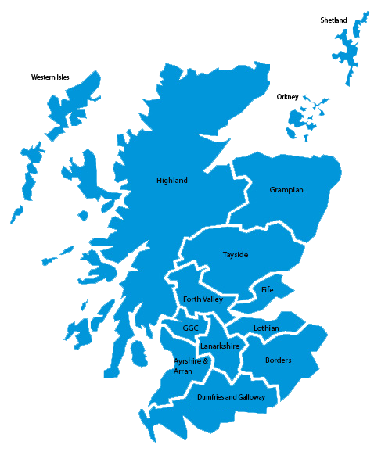
Working Well Together Matters
The NHS Education for Scotland (NES) Practice Educator National Network
We are a team of 16 Practice Educators, employed by the national health board NES and hosted within one of the 14 territorial NHS Boards.
Our iMatter report highlighted…
There was scope to improve our score in relation to:
I get the information I need to do my job well (83%)
My team works well together (88%)
We agreed we wanted…
Enhanced sense of peer support and team working to promote resilience.
More effective collaboration and cross boundary working.
And needed to overcome…
So we committed to…
The challenges presented by geographical divides and diversity in working patterns.
The challenge of balancing engagement within both our host boards and NES to maintain an informed and effective profile within each.
Explore use of a variety of mediums to strengthen communication and nurture relationships.
Proactively seek ways to collaborate, support and share practice across NHS boards.
Facilitate new members to build relations within the team.

Slide 2
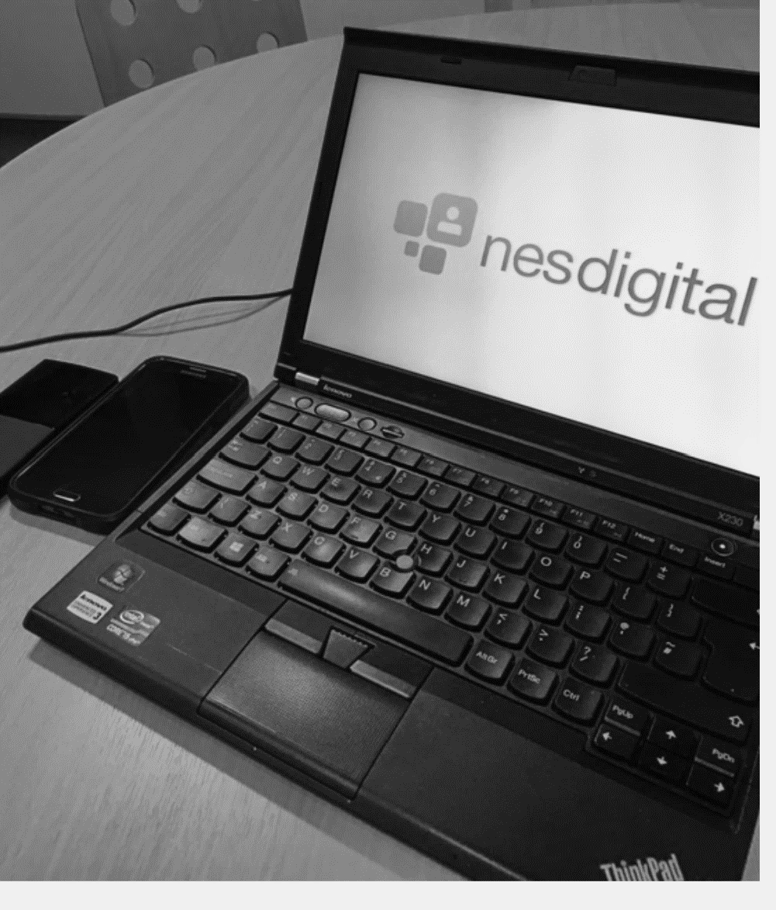
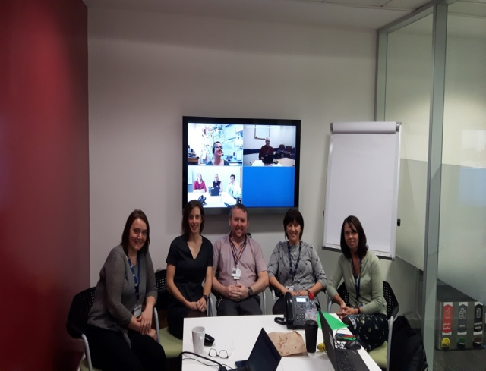
Working Well Together Matters
Explored and used a variety of digital systems to transform our team working
Facility to record in some digital systems helps promotes equity for part time team members
In acknowledgment of the value of face to face contact we continue to have this yearly event and aim to support it with the use of digital technology rather than replace it.
Great for impromptu small group working and 1:1 peer support
Effective
Team working
Skype
GoTo Meeting
Video Conference / Jabber
SharePoint
Community of Practice
Annual Gathering
What’s App
Used for team social contact
#joyatwork!
Sharing information on distributed key lead roles to facilitate efficiency in keeping up to date
Used regularly for operational meetings and as required for sub group work
Used to enable group working, sharing of resources and shared access to operational documents
Used regularly for operational meetings & to participate in wider organisation meetings

Slide 3
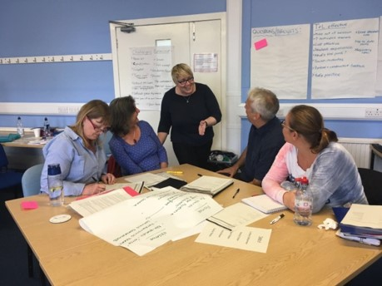
What’s working well…
Collaboration within the PE team to develop a bespoke programme utilising the established NES resource : Train the Trainers-Facilitation of Learning Toolkit
While we highly value face to face contact, these changes have helped us to achieve benefits such as:
Increased collaborative working and sharing of good practice
Enhanced peer support
Reduction in travel and increased achievement of work life balance for PEs who can’t attend face to face meetings without incurring significant travel
Development of a comprehensive induction package focusing on activities to support new practice educators upon commencement in post, enhancing peer support and team integration.
The difference it made is…
We are more effective in our use of available digital communication systems
We have enhanced our communication helping to consolidate and strengthen our relationships with each other, our NHS Board and NES colleagues
We have heightened efficiency and effectiveness within our roles through sharing learning and resources more effectively across NHS boards
We have optimised different ways of communicating for specific purposes including GoTo Meeting, Skype & What’s App, placing high value on investing in internal relations and creating resilience within the team
We have engaged more with each other regarding sharing of resources, skills and knowledge in order to support activity across NHS boards
We have developed an induction resource to help new members integrate into the role and team

