Slide 1



Rhins Community Nurses iMatter action plan
Effective replenishing of Syringe Driver cases

Slide 2

Why have we chosen replenishing syringe drivers as one of our action plans?
Rhins Community Nursing Team provide palliative and end of life care to patients including the use of syringe drivers
It would help day to day workload easier because:
If a trained member of staff gets a call out for a syringe driver, the process is more practical as the syringe driver case is already made up
The driver case has important paper work which is required for palliative patients therefore makes nursing practice more efficient if case is replenished effectively
The syringe driver case is often used by other members of the multidisciplinary team such as OOH therefore meaning that equipment is in place if any issues with the driver
Also promotes patient and family reassurance that the case has all equipment needed for any call outs, all equipment is available in the one place

Slide 3

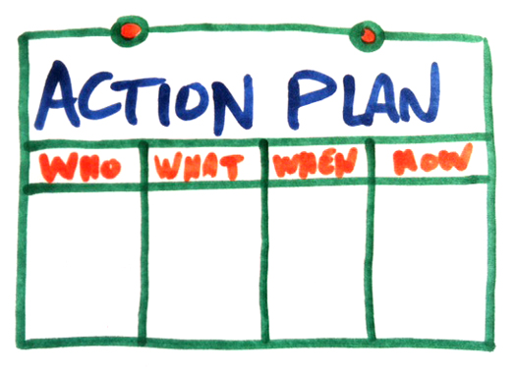
What is our action plan?
When returning syringe driver cases, it is the responsibility of the member of staff to either replenish the case or delegate appropriately to another staff member
If a syringe driver is returned by a GP or any other member of the MDT then it is responsibilty of a HCSW to replenish syringe driver case.
If a case is abandoned on a desk, then it is the responsibility of all members of staff to kindly ensure that the case is replenished and back in it is home.

Slide 4

How are we going to put our action plan in place?
PowerPoint of iMatter action plan on display for all members of staff
Email all members of the team with the plan
Include action plan in minutes of next team meeting

Slide 5


Review Date
Our team review date for this action plan is on the Wednesday 20th November

