Slide 1
Practitioner Services
Clinical
Dental Team, NSS

Slide 2

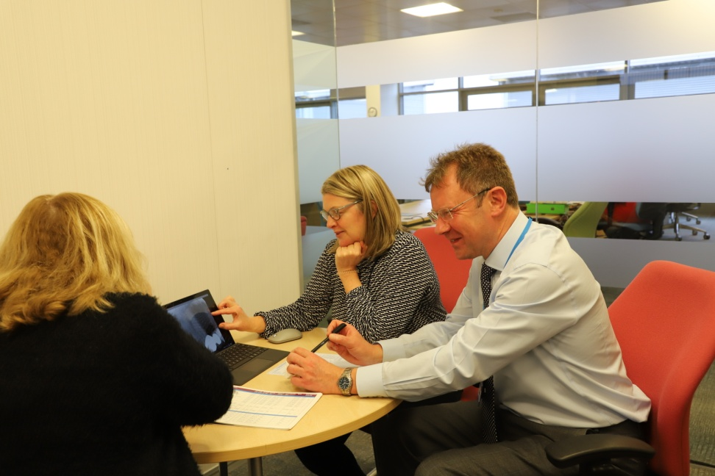
Better Involvement Makes Us Smile: The Practitioner Services Clinical Dental Team is supporting customers and patient care through increased team development and involvement in the wider organisation.

Slide 3
Our iMatter Team
Alan Whittet, Senior Dental Advisor in Practitioner & Counter Fraud Services heads up a team of dental advisers and dental reference officers, supporting prior approval treatment plans and the Scottish Dental Reference Service. We provide advice, guidance and specialist training to dental students and NHS primary care dental practitioners across Scotland.

Slide 4
Using our iMatter Storyboard
Looking at last year’s Storyboard we had a couple of desired outcomes which I feel we have made useful progress with:
The team felt it lacked involvement across the SBU and NSS and we felt that, although constrained by resource we might be well placed to make a wider contribution in some areas. Since then one team member has become the clinical lead for Adverse Incident Reporting and another is a member of a working group helping to implement the requirements of the Statutory Duty of Candour. Also, I was accepted onto the Leading for the Future programme. All of this contributes to the team having a broader knowledge of what is happening across NSS as well as making connections with colleagues working in different areas of NSS.

Slide 5
Using our iMatter Storyboard
We felt we needed a more collegiate approach to working among the Dental Advisers who are based at Gyle Square and the Dental Reference Officers who are home-based and only come into the Gyle occasionally. Whilst we did on occasion review cases together the DAs and DROs tended to do this separately as a rule. During 2018 we have moved to having peer review meetings and case conferences involving the entire team – discussions held at those meetings have had a positive effect in terms of each team member having a greater knowledge and understanding of each others’ roles and we are benefiting more from our collective knowledge and experience.

Slide 6
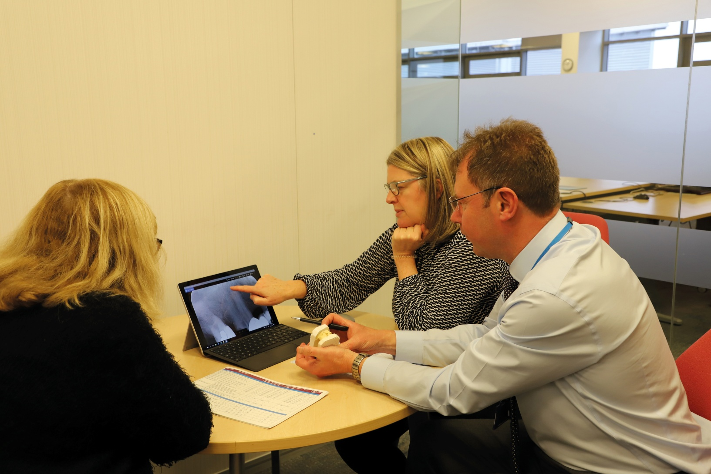
Practitioner Services - Clinical Dental Team

