Slide 1
Rhins Community Nurses iMatter action plan
Releasing time for staff to order and prescribe wound management products

Slide 2
Why have we chosen releasing time for staff to order and prescribe wound management products as one of our action plans?
Rhins Community Nursing Team can individually prescribe wound management products and order dressings from a generic system.
It would enhance our day to day team experience by:
Creating a more systematic ordering of wound management supplies.
Reducing periods of stock depletion and general work flow.
Ensuring patients have the most appropriate and specific dressings at all times.
Reducing staff annoyance and frustration and ultimately releasing more time to care for the patient!

Slide 3
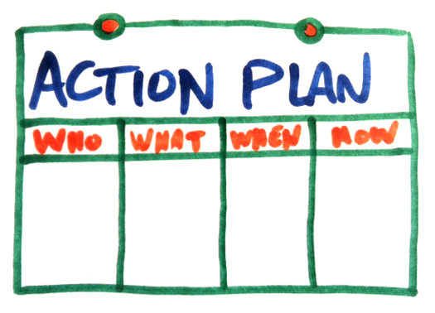
What is our action plan?
Time is allocated within the team’s daily workload to check stock levels and order wound management products on a weekly basis. A rota is created for staff members to take ‘turns’ on a monthly basis. If that staff member is due to be off/on annual leave, it is their responsibility to delegate this task to another staff member.
Time is allocated within the team’s daily workload for qualified Community Nurse Prescribers to complete and process patient specific prescriptions on a twice weekly basis.

Slide 4
How are we going to put our action plan in place?
PowerPoint of iMatter action plan on display for all members of staff
Email all members of the team with the plan
Include action plan in minutes of next team meeting

Slide 5
Review Date
Our team review date for this action plan is on the Wednesday 20th November

