Slide 1

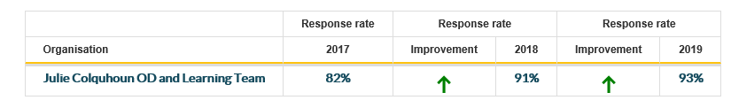
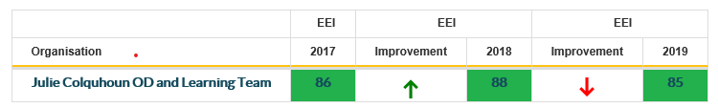


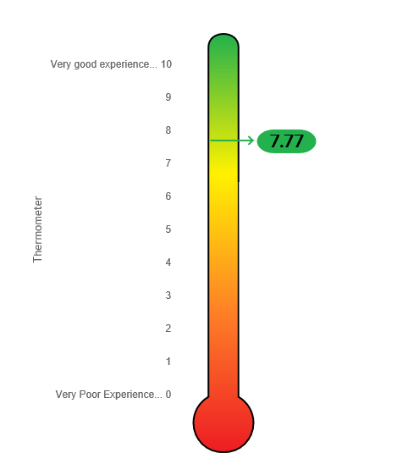

Excellent Response rate from the team
Quite a bit of change to the team over the previous 12 months which resulted in a slight drop in EEI
Working together in an open plan space has real opportunities to improve communication across the team which is welcomed
iMatter Team action plan identified a need to spend some time together exploring a little more about who the team are and what they do – learning a little bit more about the team and self.
The Team Celebrated the significant role they played in the preparation for and during the migration to the new hospital in June.
Team Development day was well spent mapping out roles and responsibilities , it included a lot of fun during the day – which continued on into the evening!

