Slide 1
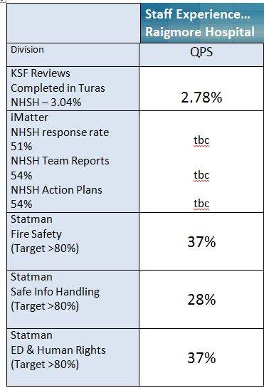
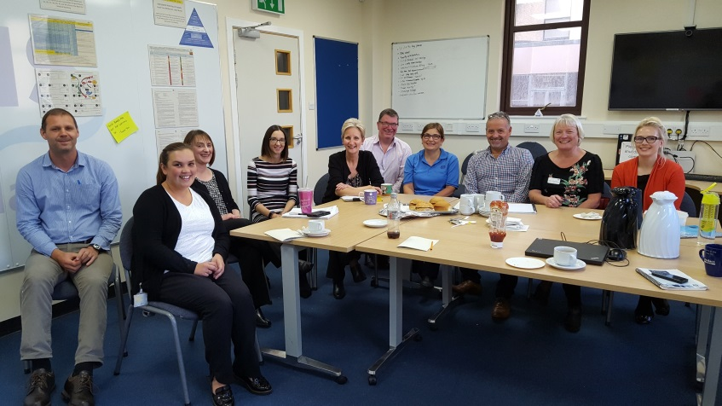
Bridging the gap Understanding the issues facing QPS teams
“on the face of it our action plan looked very simple…”

Slide 2
On the face of it our iMatter action plan looked very simple, the reality was far different. We felt that there was a real need to share our concerns with senior managers regarding the issues QPS teams faced on a daily basis and started to look at how our Staff Experience metrics could be used to make improvements.
In our action plan we agreed an outcome around the board having an increased awareness of the issues we face and plan to invite the Employee Director to meet with us and to discuss the issues we feel are having the most impact on our teams and their ability to provide safe and effective services for our patients.
We realised we had access to a captive audience at the weekly Wall Walk and could use the live data to highlight to senior managers specific issues about releasing staff to attend Statman training and also about managing access to IT and PC’s to enable staff to engage with our on-line systems (Turas Appraisal and Learnpro).
It felt like there was a gap that needed bridging between the expectations of the organisation and the reality faced by QPS teams and staff, the Wall Walk data and iMatter action plan kind of came along at the right time and has given us a renewed focus on how to improve staff experience.
At the end of our rainbow is a management team committed to working together to improve staff experience albeit fortified by bacon rolls.

