Slide 1
Saying ‘Well done’ & ‘Thank you’
in The Emergency Department

Slide 2
The Power of Positivity
We wanted to improve our staff sense of value and appreciation for their work.
We have created a simple form for any member of staff to complete when they see ‘Excellence’!
What is Excellence? – well that is up to the individual:
Great care
Brilliant Teamwork
Going the ‘extra mile’
What happens?
We thank the nominator
We inform and thank those nominated for doing an awesome job
We tell their supervisor
We share the learning anonymously

Slide 3
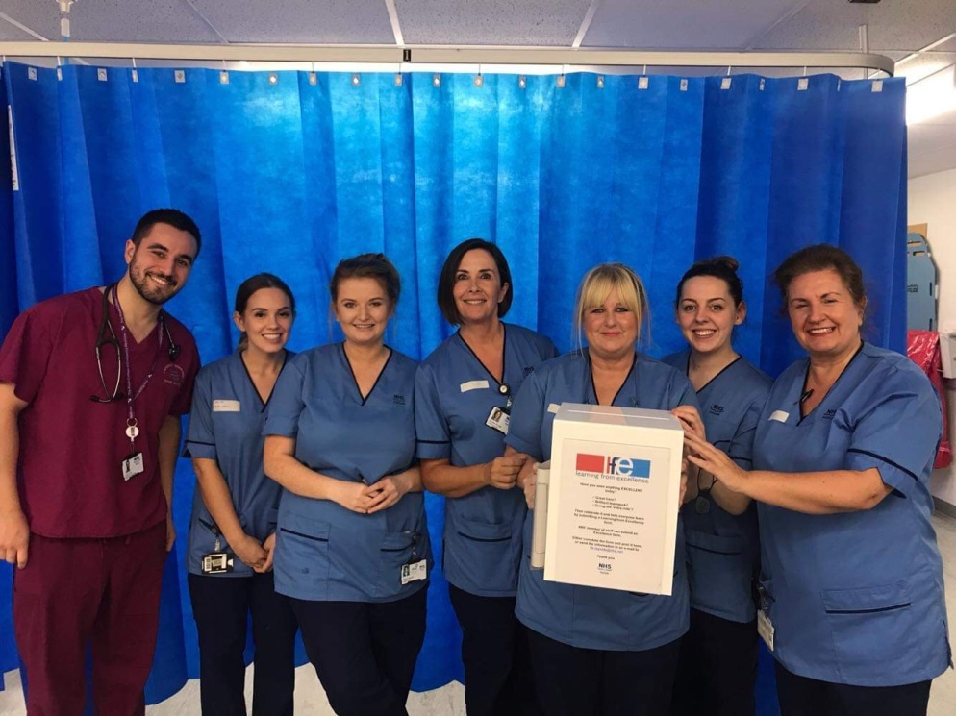
The team have fully supported the project
97 forms have been completed over a 9 month period, resulting in 150 thank you letters being sent out. Letters have been sent to ED doctors, nurses, HCA and out to Housekeeping, Cardiology, Anaesthetics, BTS, SAS, Site management, Interpretation services, Plastics, Pharmacy, Orthopaedics, ENT and Paediatrics.

Slide 4
And the feedback?
Extremely humbled and grateful to your department for this unexpected and greatly appreciated surprise.
Thank you very much for the recognition
Thank you ever so much, that has made my week!
Thanks so much, that’s a lovely gesture and much appreciated
That’s the nicest feedback I have ever had in my 14 year medical career
This makes me want to do a form for someone else

Slide 5
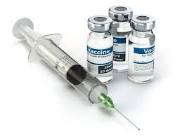
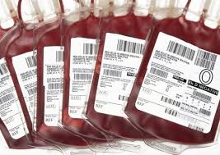
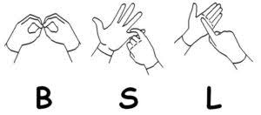
What have we learned?
A new way to tie a Thomas splint
All about the major haemorrhage protocol
The changes to vaccination services
Better communication techniques

Slide 6
What’s next?
We will continue to provide positive feedback, share and celebrate excellence
Use this as a tool to drive cultural change, so that we can work together better and provide safer patient care
Spread the word and support those who wish to start a similar project in their department.
“... The two most powerful words in the English language are ‘well done’”
Sir Alex Ferguson

Slide 7
The ED Team
Dr Alison White, Dr Liz Skelly, Susan Henderson (Clinical Audit Facilitator),
Lisa Maloney (Secretary), Mhairi McLeay (Secretary),
Stuart McAllan (Improvement Advisor), Louise Whyte (CN),
Gill Morgan (SN), Jenny Burdge (CN), June Gilfillan (CN).

