Slide 1
NHS Western Isles Emergency Department
- Get Involved. Make a Difference -
A focus on providing the best service for patients is paramount to the team. The team feel they have role clarity, effective team working, are empowered to influence and have confidence in their direct line manager.
Involved in Decisions
Performance Management
Visible Leadership
Staff are asked to identify areas where they think performance is not managed or supported well.
Agree with staff a level of visibility and leadership from senior managers that is appropriate and situations where they feel it is not visible.
Staff are encouraged to give examples of when they have not felt involved to decisions relating to the organisation.
Ensuring staff are informed of wider organisational objectives is key.
Feedback to senior management.
The manager will actively highlight to senior managers the areas where performance management is felt not to be managed well.
Manager will openly encourage senior managers to increase visibility within the organisation.

Slide 2
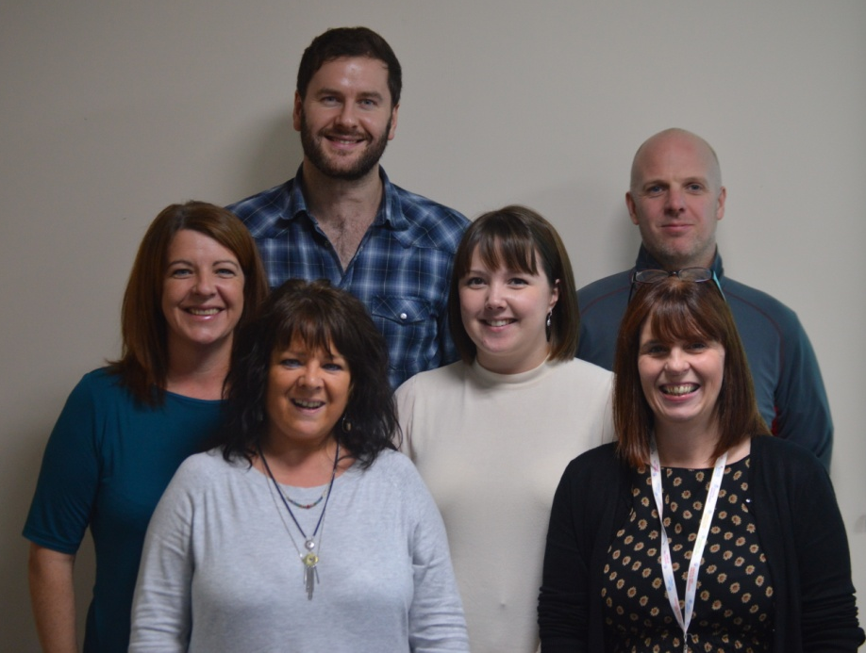
Susan Macaulay - Emergency Department Manager
"As a manager, iMatter is useful to identify areas where staff are not happy and gives the opportunity to address any issues. I value the information iMatter provides and listening to your team and addressing problems together is one of the most important actions, I can do as a manager."
Janette Murray- Emergency Nurse Practitioner
"This is an excellent opportunity to provide feedback effectively.
It's great to know that our opinions are being valued”

