Slide 1
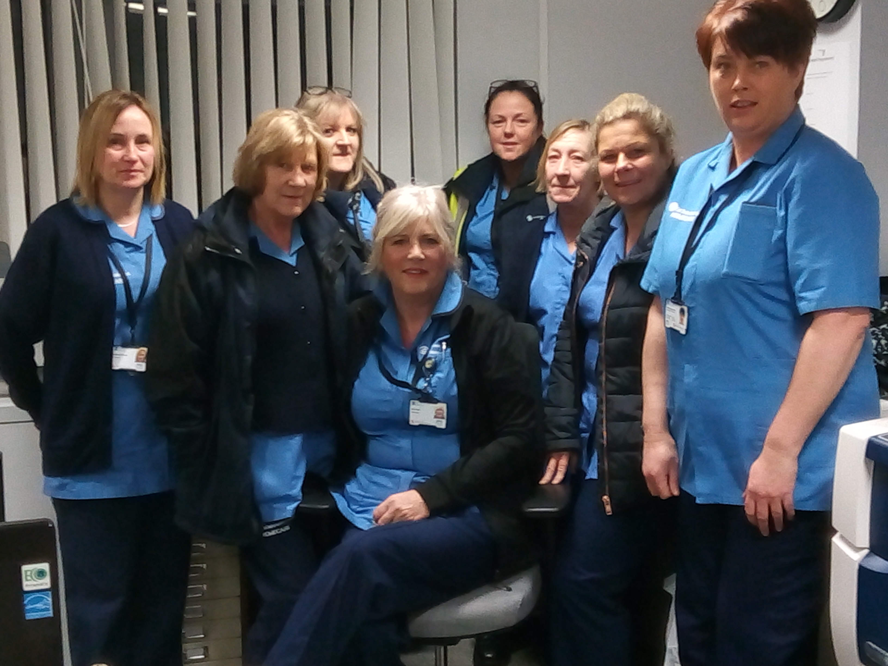
iMatter to Home Care The Journey
East Dunbartonshire Health and Social Care Partnership

Slide 2
The Start
“When I first heard the phrase iMatter my initial thought was that’s a laugh I certainly don’t matter – I thought here we go yet another meaningless questionnaire that will go nowhere” Trish Watson, Home Care Organiser Reablement
Originally designed for Health but was used in all services across the East Dunbartonshire Health and Social Care Partnership including the Home Care Service.

Slide 3
The Middle
Rolling iMatter out to over 200 Carers who are not on the Council network was a complex and time consuming task.
However it was duly completed and the reports generated. We all felt proud when we discussed what we do well and realised that being part of the Home Care Team was a special place to be.
“After my initial misgivings I answered the questions honestly and was pleasantly surprised at the results” Trish Watson, Home Care Organiser, Reablement
What we do well:
Problem solving, ability to find imaginative solutions within dedicated resources

Slide 4
Now and the Future
Area for improvement:
Improving information sharing and communication
Action:
Implementation of a quarterly Home Care Newsletter
An e-mail has been circulated for contributions to the first Newsletter with a closing date of 30th November 2017. The first Newsletter is to be launched at the end of December 2017/ beginning of January 2018.
”The Newsletter will keep all the home care staff up to date on any organisational changes as well as personal achievements such as the Graduation photos for SVQ 4 qualifications and the completion of training to be Moving and Handling Assessors. It will also highlight the successful partnership working with our colleagues in Health in our work with Falls, Skin Integrity and Nutrition” Margaret McCracken, Home Support Manager

Slide 5
Now and the Future
Area for Improvement:
Promotion of participation and involvement in decision making
Action:
Introduction of a Home Care Quality Circle with representation from carers, organisers review officers and system assistants.
The terms of reference have been completed and nominations have been received for the Quality Circle. First meeting is planned for December 2017.
“ The first topic for the group is going to be Personal Development Reviews and this will give us the opportunity to contribute to making them real and meaningful whilst strengthening the links to the Team Plan. When I first heard the phrase iMatter I was very sceptical but I now feel that I really do matter” Home Care Organiser, Reablement.

