Slide 1
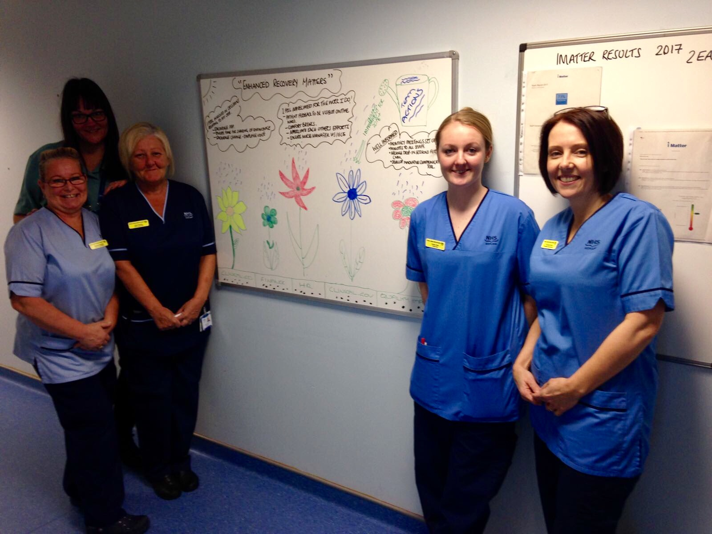

Slide 2
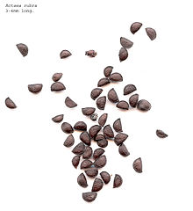
“ENHANCED RECOVERY MATTERS”
Team actions
I FEEL INVOLVED IN DECISIONS RELATING TO MY JOB
Encourage PDP
Ensure time for sharing of knowledge
Encourage change – employee voice
I FEEL APPRECIATED FOR THE WORK I DO
Patient feedback to be visible on the ward
Comfort breaks
Appreciate each others’ efforts
Ensure nurse manager visible
Ongoing improvement for 2018 +
WELL INFORMED
Monthly meetings set up
Minutes to all staff
Arrange drop in sessions for CNM
Develop innovative communication tool
Clinical Ed.
Finance
HR
Clinical Gov
Quality Improvement

Slide 3
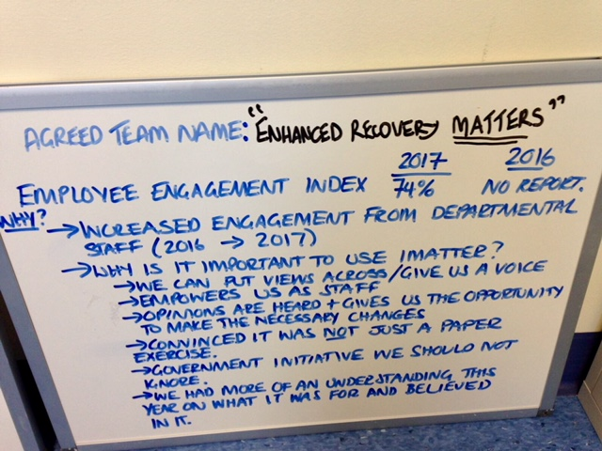

Slide 4
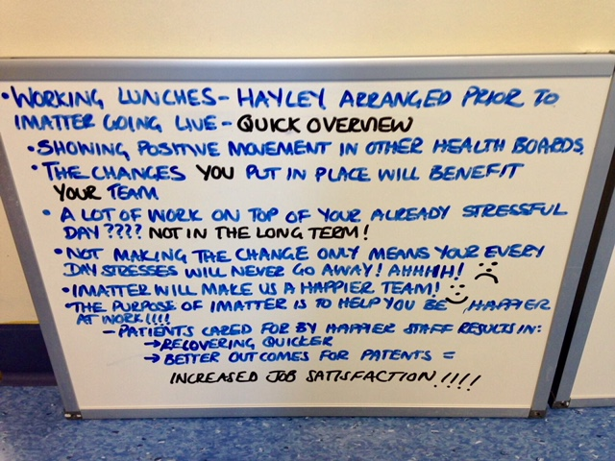

Slide 5
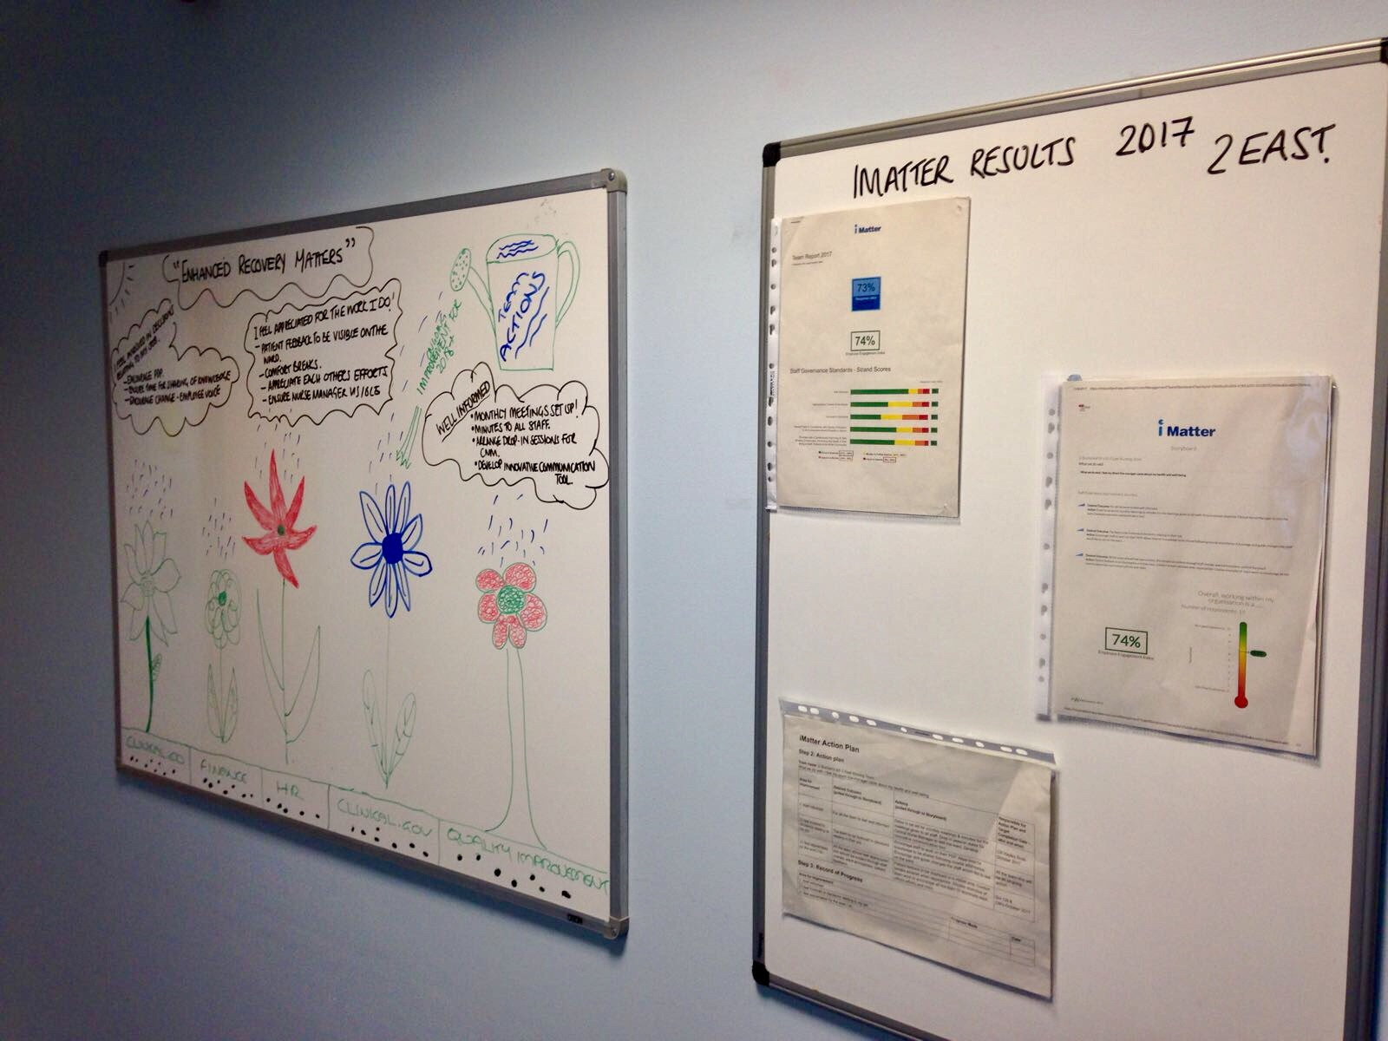

Slide 6
