Slide 1
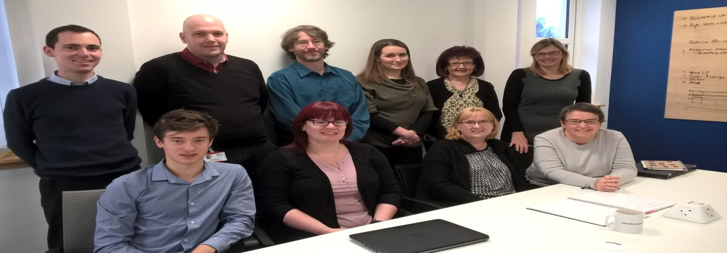
“the planning department without a plan”
We had no team report but we used the Directorate Report
…reduced waste, identified Standard Work and equalised distribution of Variable Work to release time and create capacity for team development
We released time for analysts to visit other departments and work closer with “customers”
We addressed - I have sufficient resources to do my job well
We saw how we could develop team priorities and create a plan aligned to the Strategic Vision

Slide 2
