Slide 1
Governance and Operations Team
iMatter story

Slide 2
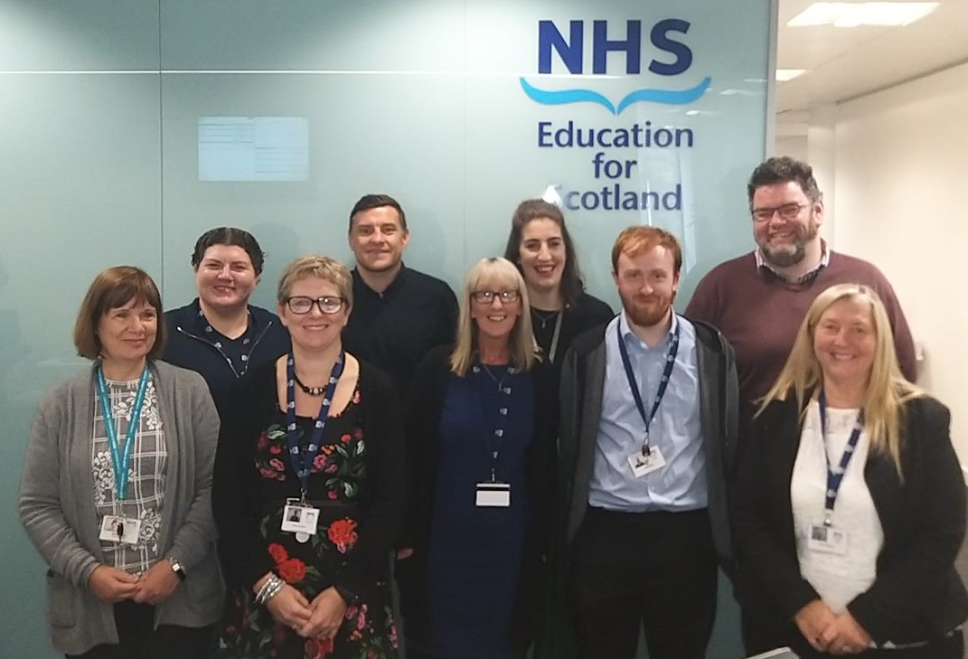
Welcome to our team – we are the - Governance and Operational Team
The Governance and Operational team is a team of 10 people who are part of the larger Finance team of 31 at NES. One of our team is not in our photo unfortunately, due to annual leave.
The team is based in Westport in Edinburgh. We are sharing our iMatter story for 2018 with you.

Slide 3
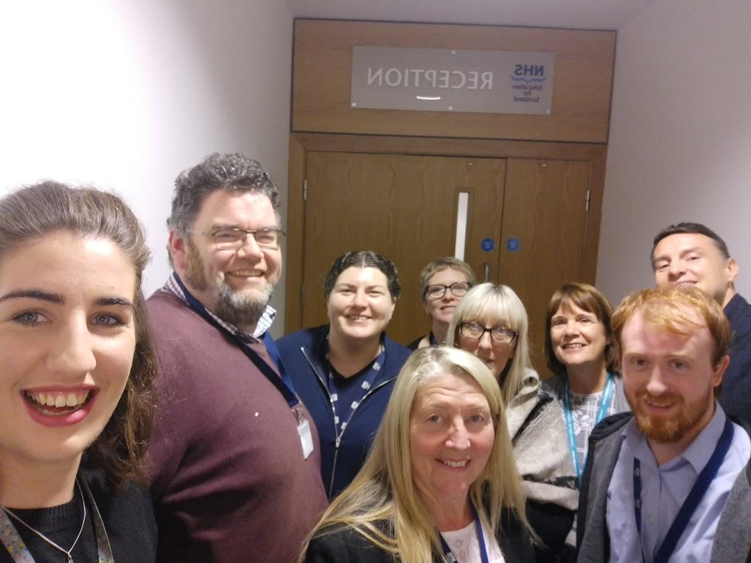
What does our team do?
We ensure all of our supplier invoices are processed and paid
We send out customer invoices and record/chase income
We ensure all statutory payments are reconciled and paid
We work with our colleagues at NSS to pay all of our staff (which includes all of the GPSTs in NHS Scotland)
We process manual expenses
We monitor cashflow
We work hard
We strive to always improve
And much, much more….

Slide 4
iMatter – Lets start with what we do well
We work very well together as a team
Collectively and individually we achieve our objectives
We meet our deadlines
Improvements to existing processes is something we always have in our sight and if we find a way to make efficiency savings we will always endeavour to achieve that

Slide 5
iMatter – How do we achieve this?
We are willing to change and we keep our minds open
We can adapt when we face new challenges
Most importantly, as a team we support each other and …

Slide 6
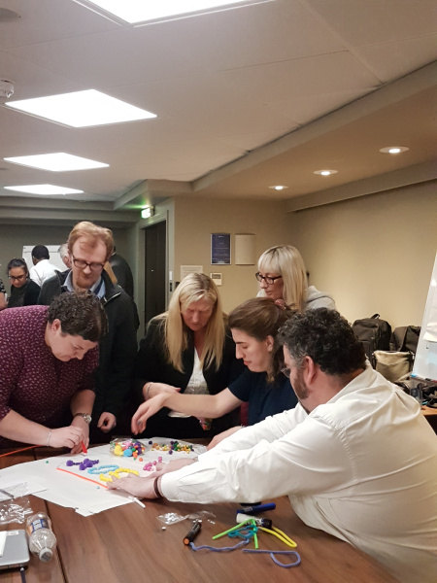
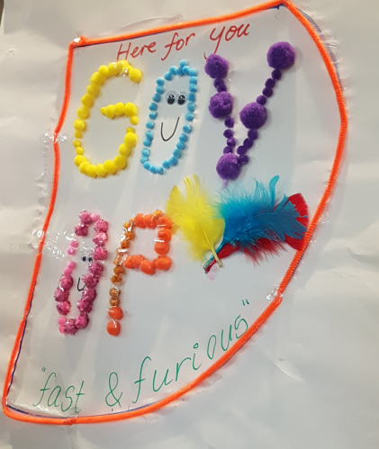
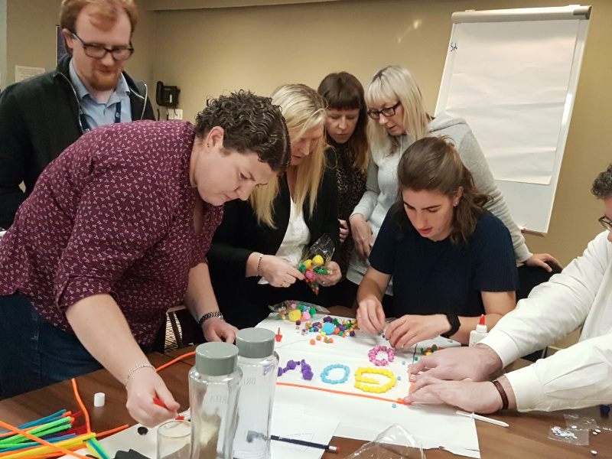
iMatter – How do we achieve this?
………we have fun

Slide 7
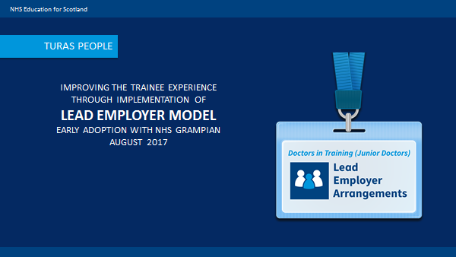
iMatter – what we do well
Our ability to adapt to change and face new challenges was evident when NES became the Lead Employer for GP Trainees. This entailed NES employing an additional 600 GP Trainees across Scotland.
Responsible for payroll and expenses, our workload increased overnight and we developed and learned brand new processes to deal with the new scenarios.
We are now liaising regularly with many more colleagues across Scotland to ensure we improve the trainee experience.
And we are learning!

Slide 8
iMatter – what are our challenges
We are so busy working to meet our deadlines and to provide a good service that we don’t get enough time to learn and develop.
It would be great if we could:
spend some time training new team members
learning ourselves
trying new things.

Slide 9
iMatter – Desired outcome
A well trained team who are confident in their roles and given time to learn.
We have lots of written procedures, but they do tend to go out of date quickly. We agreed to review the procedures with a view to ensuring they are all updated. This will help a new team member who is not familiar with NES or the processes – it will give them a reference point to help them to do their job independently. Although we are happy to train our colleagues it will reduce the amount of time we need to spend with them explaining the basics – instead that time could be used to enhance their knowledge

Slide 10
iMatter – Desired outcome
A well trained team who are confident in their roles and given time to learn.
We are asked to cover for each other during leave or absence but we don’t always know each other’s tasks. This means it can take a long time to accurately complete a task as we are unfamiliar with it.
We agreed to free up time for team members to work together to share knowledge. A rota system was incorporated whereby each member of the team has an opportunity to work on each relevant task for their role and learn it – with their colleagues on hand to provide advice.

Slide 11
iMatter – Desired outcome
A team who is aware of their performance through feedback
We all work hard and we want to do as good a job as possible. We sometimes find out when things go wrong, but we also would like to hear about when things go well.
We agreed to add training and feedback as a standing item to our one to one and peer group meetings. In those meetings we encourage openness and debate to help all of us understand what is expected of us, what barriers we encounter and what we all think we could do better.

Slide 13
i-Matter
Thank you for reading our story
Notes:
.

